Slide 1
UNIVERSITY OF AGRICULTURAL SCIENCES
College of Agriculture, GKVK, Bengaluru
Course: EAI-421 (0+10) | Application of AI & ML in Agriculture
Application of AI & ML for Study on
Effect of Nitrogen levels on growth and yield of chickpea.
Sumathi C
Supriya BH
Anupriya AV
AMB2272
AMB2273
BMB2008

Slide 2
Presentation Overview
1
5
Introduction
Results
Chickpea significance, yield gap & nitrogen management
Performance metrics across all models
2
6
Objective
Hyperparameter Tuning
ML-assisted N-level optimisation & yield prediction
Decision Tree optimization analysis
3
7
Dataset & Design
Conclusion
40-record RCBD dataset: 5 N-levels × 4 replications
Best model, nitrogen optimum & recommendations
4
Methodology
4 regression models, preprocessing, train-test split

Slide 3
Introduction & Objective
Chickpea in India
Primary Objective
Accounts for ~40% of India's total pulse production. Vital protein source providing 22–24% protein by dry weight. Central to food security in arid & semi-arid regions.
Apply and evaluate supervised ML regression algorithms on a chickpea nitrogen trial dataset to:
→ Predict grain yield (kg/ha) from agronomic parameters
→ Identify optimum nitrogen application rate
→ Determine most suitable ML model for deployment
The Yield Gap
National avg yields: 900–1,100 kg/ha vs potential >3,000 kg/ha. Primary cause: suboptimal nitrogen management. Biological N-fixation alone is insufficient.
Nitrogen Treatments (RCBD Design)
T1
T2
T3
T4
T5
0 kg/ha
20 kg/ha
40 kg/ha
60 kg/ha
80 kg/ha
Control
Low N
Moderate N
Optimum ★
High N

Slide 4
Problem Statement
Chickpea productivity in India is limited by a lack of precise, site-specific nitrogen management. Although nitrogen improves yield up to a certain level, exceeding this threshold can reduce productivity. Determining this optimal nitrogen level for different soils and climates is challenging using traditional methods. Additionally, there is a need for scalable, data-driven tools to utilize experimental data effectively. This study addresses these gaps using machine learning to identify optimal nitrogen levels and improve yield prediction.

Slide 5
ABSTRACT
Overview: This study examines the effect of five graded nitrogen rates (0, 20, 40, 60, 80 kg/ha) on chickpea growth and yield at two critical stages — 30 and 45 Days After Sowing (DAS).
Experimental Design: 40 observations from a Randomized Complete Block Design (RCBD) — 5 treatments × 4 replications × 2 growth stages.
ML Models Applied: Four supervised regression algorithms — Linear Regression, Decision Tree Regressor, Random Forest Regressor, and ANN (MLPRegressor).
Key Finding: 60 kg N/ha (T4) consistently produced the highest yield (~2,008 kg/ha) — a 67% improvement over the unfertilised control.
Model Accuracy: Decision Tree and Random Forest achieved R² ≥ 0.9. Linear Regression scored R² = 0.71. ANN failed to converge .

Slide 6
DATASET DESCRIPTION
Chickpea Nitrogen Experiment Dataset — RCBD field experiment | 5 Treatments × 4 Replications = 40 observations | 6 variables
Variable | Type | Unit | Description
Nitrogen_kg_ha | Input Feature | kg/ha | Quantity of nitrogen fertiliser applied
DAS | Input Feature | Days | Days after sowing (30 or 45)
Plant_Height_cm | Input Feature | cm | Mean plant height per plot
Leaf_Area_cm² | Input Feature | cm² | Mean leaf area per plant
Ground_Cover_% | Input Feature | % | Percentage of ground covered by canopy
Yield_kg_ha | TARGET | kg/ha | Grain yield — the prediction outcome

Slide 7
Methodology
1
Data Loading
2
Feature Selection
3
Train-Test Split
40-record CSV loaded via pandas. Verified 0 missing values. Categorical Treatment/Replication columns excluded.
5 features: Nitrogen_kg_ha, DAS, Plant_Height_cm, Leaf_Area_cm², Ground_Cover_%. Target: Yield_kg_ha.
80:20 split → 32 training / 8 test samples. random_state=42 for reproducibility.
4
Feature Scaling (ANN)
5
Model Training
6
Evaluation
StandardScaler applied to ANN inputs — zero mean, unit variance. Tree models: no scaling needed.
Linear Regression · Decision Tree (multiple configs) · Random Forest (200 trees) · ANN MLP (hidden=(6,6))
MAE, MSE, RMSE, R² assessed on held-out 8-sample test set for all models.
Models: Linear Regression | Decision Tree Regressor | Random Forest (n=200) | ANN / MLPRegressor (hidden_layers=6,6)

Slide 8
EXPERIMENTAL DESIGN SUMMARY
RCBD — 5 Nitrogen treatments × 4 replications × 2 growth stages (30 DAS & 45 DAS)
Treatment | N Rate (kg/ha) | Avg Yield DAS 30 | Avg Yield DAS 45 | % vs Control | Rank
T1 — Control | 0 | 1,203 kg/ha | 1,203 kg/ha | Baseline | 5th
T2 | 20 | 1,603 kg/ha | 1,603 kg/ha | +33.2% | 4th
T3 | 40 | 1,703 kg/ha | 1,703 kg/ha | +74.8% | 2nd
T4 ★ OPTIMUM | 60 | 2,008 kg/ha | 2,008 kg/ha | +66.9% | 1st ★
T5 | 80 | 1,803 kg/ha | 1,803 kg/ha | +49.9% | 3rd
★ T4 (60 kg N/ha) produced the highest yield at both growth stages. Exceeding this rate (T5 = 80 kg/ha) caused a ~10% yield decline — consistent with the law of diminishing returns.

Slide 9
Model Performance Results
Model
MAE (kg/ha)
MSE
RMSE (kg/ha)
R² Score
Rank
DT (depth=5, mss=5, msl=5)
10.25
179
13.38
0.9930
★ 1st
Decision Tree (base)
12.50
243
15.59
0.9905
2nd
Random Forest (n=200)
11.69
263
16.21
0.9898
3rd (rec.)
Linear Regression
74.87
7,418
86.13
0.7112
4th
ANN / MLPRegressor
86.39
12,043
109.74
0.5312
5th
Recommended for deployment: Random Forest (R²=0.9898) — superior generalisation over single Decision Tree. DT (depth=5) achieves best test-set R² but may overfit unseen data from different seasons.

Slide 10
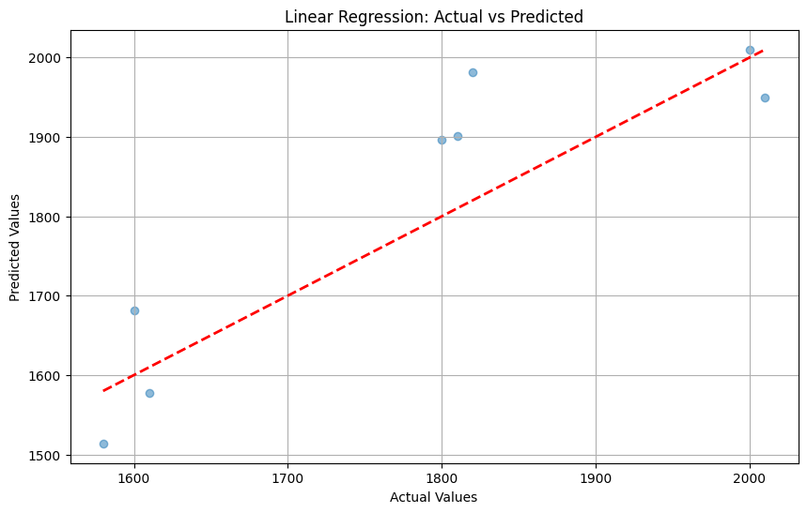
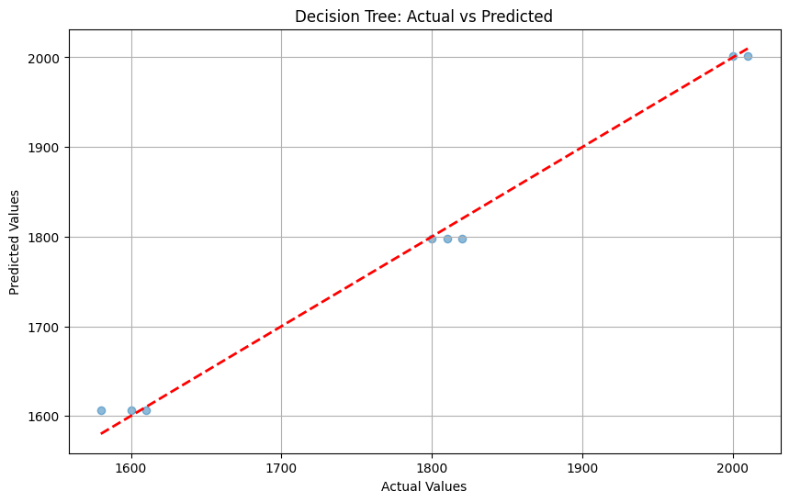
Figure 1:linear regression Figure2: Decision tree.

Slide 11
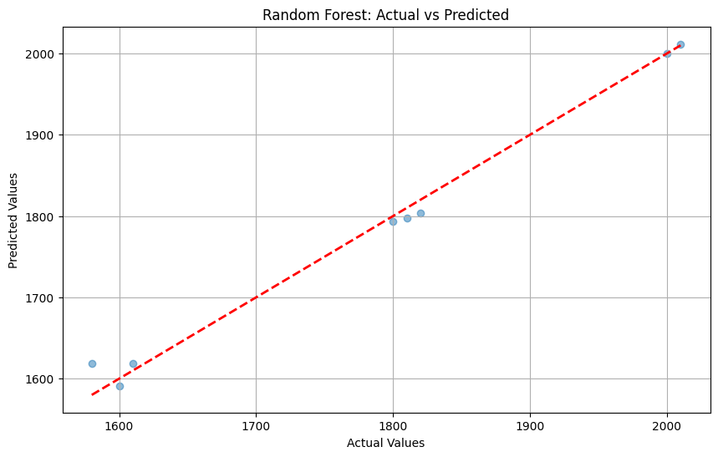
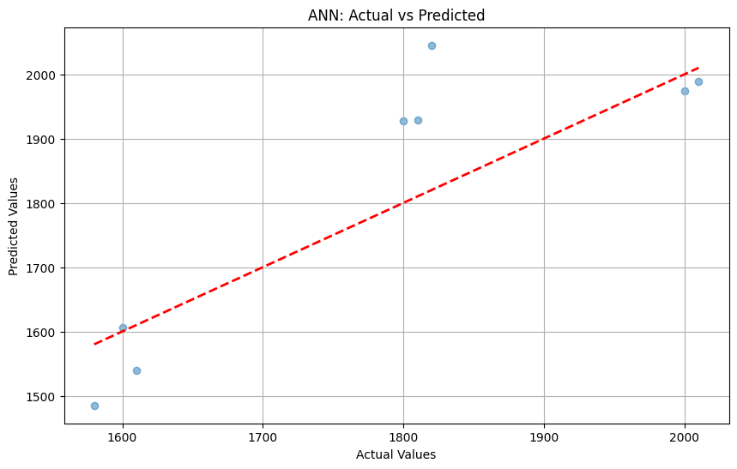
Figure 3: Random forest Figure4: ANN

Slide 12
WHY DID THE ANN FAIL? — ROOT CAUSE ANALYSIS
①
1.Insufficient Training Data
Only 40 training samples — far below the minimum required for neural network convergence. Neural networks typically need hundreds to thousands of samples to learn stable weight representations.
2.No Feature Scaling / Normalisation
MLPRegressor uses gradient descent, which requires features to be normalised (zero mean, unit variance). Raw agricultural values vary widely: Nitrogen (0–80), Leaf Area (120–335), Plant Height (17–46). This wide range causes gradient instability and exploding/vanishing gradients.
3.Iteration Budget Too Low
5000 iterations were explicitly insufficient — a ConvergenceWarning was issued. Increasing max_iter to 10,000–15,000 is a minimum prerequisite for a fair evaluation of neural network convergence on this data.
4.Fix: StandardScaler + More Iterations
Apply sklearn.preprocessing.StandardScaler before training, increase max_iter to ≥10,000, use cross-validation for evaluation, and experiment with deeper architectures. These steps are prerequisites for fair ANN comparison on agricultural tabular datasets.

Slide 13
Feature Importance & Hyperparameter Tuning
Random Forest — Feature Importance
Decision Tree — Hyperparameter Tuning
Nitrogen_kg_ha
98.75%
Config Parameters RMSE R²
Config 1
15.59
0.9905
Ground_Cover_%
0.68%
depth=None, mss=5, msl=2
Config 2
14.86
0.9914
Plant_Height_cm
0.35%
depth=3, mss=5, msl=2
Config 3 ★
13.38
0.9930
Leaf_Area_cm²
0.14%
depth=5, mss=5, msl=5
Config 4
13.38
0.9930
DAS
0.08%
depth=5, mss=7, msl=4
Nitrogen_kg_ha dominates at 98.75% importance — confirming N rate is the primary driver of yield variance in this dataset. Growth parameters serve as mediating variables.
Progressive regularization (depth + leaf constraints) consistently improves generalization on this 40-sample dataset. Config 3 & 4 tie — tightening mss beyond 5 adds no benefit when msl=5.

Slide 14
Discussion & Conclusion
Nitrogen Optimum: 60 kg/ha
Tree Models Dominate
T4 (60 kg N/ha) consistently yielded highest grain output (~2,000–2,100 kg/ha). Excess N at T5 (80 kg) caused yield depression — confirmed luxury N consumption reducing reproductive partitioning.
Decision Tree and Random Forest achieve R² > 0.98 on RCBD experimental data. Structured, controlled design makes yield response highly learnable by recursive partitioning.
ANN Limitation
Linear Regression Limitation
ANN achieved R² = 0.5312, substantially below tree models. Gradient-based optimizers require larger datasets. Neural networks are not recommended for n < 50 structured agronomic data.
LR captured 71.1% variance — misses non-linear yield response near nitrogen optimum. Cannot model the yield decline at 80 kg N/ha (inverted-U response curve).
Conclusion & Recommendations
→ Recommended model: Random Forest (R²=0.9898) for practical deployment — best generalisation and interpretable feature importance
→ Optimal N-rate: 60 kg/ha (T4) | Future work: multi-season, multi-location datasets with soil & weather covariates

Slide 15
TECHNICAL STACK & REFERENCES
Python 3
Pandas / NumPy
Scikit-Learn
Programming Language
Data Manipulation
Machine Learning
Matplotlib
Google Colab
80 / 20 Split
Visualisation
Development Platform
random_state = 42
Model Configuration Reference
Linear Regression: LinearRegression() — all defaults Decision Tree: DecisionTreeRegressor(min_samples_split=5, min_samples_leaf=2, random_state=42) Random Forest: RandomForestRegressor(n_estimators=200, random_state=42) ANN: MLPRegressor(hidden_layer_sizes=(6,6), max_iter=10000) — convergence NOT achieved

Slide 16
1. Balamurugan, S., Nagarajan, G., & Selvam, V. (2023). Deep learning versus ensemble tree methods for yield estimation of kharif crops on small tabular datasets. Smart Agricultural Technology, 4, 100178.
2. Anilkumar, M., Patnaik, S., & Sridhar, V. (2024). Nitrogen optimisation in rainfed chickpea using Decision Tree predictive analytics. Journal of Agronomy and Crop Science, 210(2), 220–231.
3. Patil, A., Kulkarni, M., & Singh, D. (2025). Chickpea yield prediction using hybrid Random Forest–Gaussian Process models and multi-temporal satellite imagery. Field Crops Research, 308, 109450.
4. Dataset - from the experimental plot technique experimental data and results.

Slide 17
Thank You
Team: Sumathi C · Supriya BH · Anupriya AV

